Slide 1
Title: Design Activity document of Open-Ended Assessment
Reddit – social media application
Name | Roll no | SRN
Shrinidhi | 443 | 01fe20bcs227
Nayana | 451 | 01fe20bcs235
Ranjeeta | 458 | 01fe20bcs027
Team Number:6(D2)
Faculty In-charge:
KMMR
SCHOOL OF COMPUTER SCIENCE & ENGINEERING
Academic year 2021-22

Slide 2
1.1Problem Statement
Introduction
Reddit is a network of communities where people can dive into their interests, hobbies and passions.
Users can register themselves on the platform. They can join subreddits based on their interests. These communities are moderated by moderators. Users can submit their posts in the subreddits in the form of text, images or video. They can view posts and upvote or downvote them. Users can also award the posts they like. They can comment on other posts. Users can also reply to the comments. They have an inbox where they receive notifications and messages.

Slide 3
1.2 Features of Application
User can explore to all the features of the only if he sign-In or log-In
to the app.
User can join various subreddits of his interest and he can upvote, downvote, comment or reply to the post there.
If user has more karma points he can create his own subreddit and post ,posts can be in the form of text, image or video.
Apart from these user have other features like chats, search and notification bar.

Slide 4
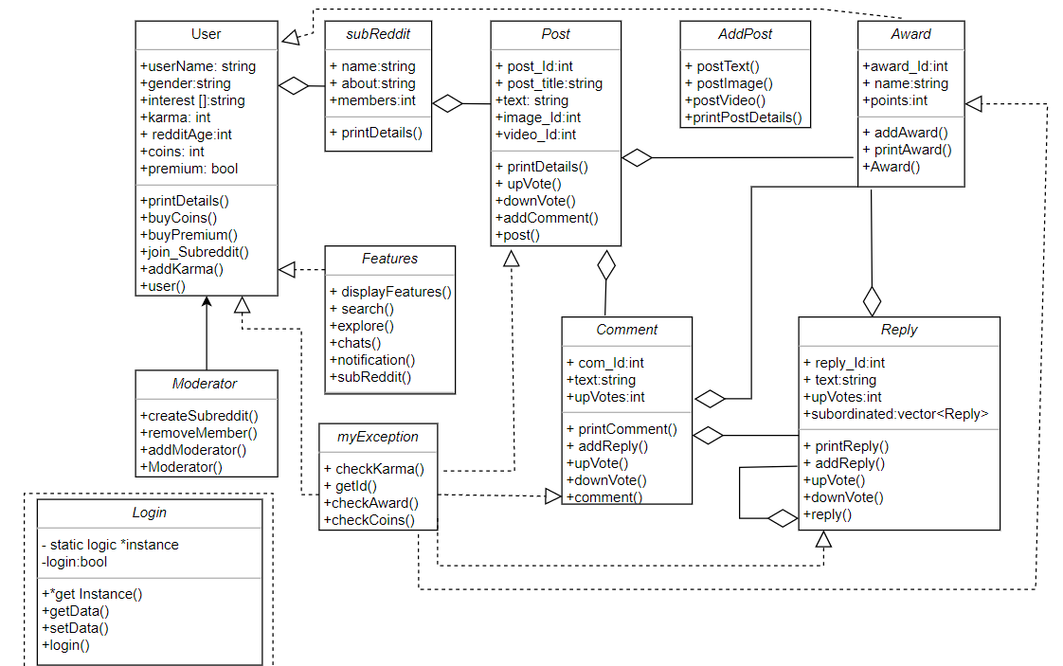
2.Class diagram

Slide 5
4.1 Test Plans
Case1:output: Reddit
1.LogIn 2.signIn 3.Features 4.exit
Enter your choice-
Input-3
Output: You have to sign-in or log-in first
Case2:output: Reddit
1.LogIn 2.signIn 3.Features 4.exit
Enter your choice-
Input-1
output: Enter your name
input: aa
output: Enter your gender
input: female
output: create password
input:*****

Slide 6
Case 3- output: 1.create subreddit 2.Addpost 3.Features 4.exit
input:1 (condition karma<500)
output: Not enough karma
Case 4-output: Reddit
1.LogIn 2.signIn 3.Features 4.exit
Enter your choice-
Input-2
output-Enter your password
input-***
output-Enter the correct password
Case 5- output: 1.create subreddit 2.Addpost 3.Features 4.exit
input:1
output-Enter subreddit name
input-art
output-Enter about
input- aaaa
output-Enter category
input-artist
output-Subreddit created

Slide 7
4.2 USE CASES
Simple Reddit Use Case:
User uses Reddit App
User Sign-In to the app
User can explore more through the features
User joins subreddit
User comments on posts
User upvotes, downvotes and gives awards to posts, comments and replies.

Slide 8
​ ​ USE CASE 1​ | ​ ​ Using Reddit app​
​ ​ ACTOR​ | ​ ​ User(Social Media Users)​
​ ​ ​ BASIC FLOW​ | When the user first uses the Reddit app he need to create an account by signing in filling all the details like name, gender and selecting his interests and joining the various sub-Redditt's .​ He can comments on the posts present in the sub-reddit ​ He can upvote, downvote the posts and comments.​ ​

Slide 9
Middle weight Reddit use case
User uses Reddit app
User Log-In to the app
User buy Reddit Premium
User joins subreddit
User can add posts on subreddit
User can explore more through the features
User comments on post
User upvotes, downvotes and gives awards to posts, comments and replies.

Slide 10
​ USE CASE 1​ | ​ Using Reddit app​
​ ACTOR​ | ​ User(Social Media Users)​
​ ​ BASIC FLOW​ ​ | When the user first uses the Reddit app he need to create an account by signing in filling all the details like name, gender and selecting his interests and joining the various sub-Redditt's .​ He can comments on the posts present in the sub-reddit ​ He can upvote, downvote the posts and comments.​
​ ALTERNATIVE​ FLOW 1​ | ​ Apart from the basic flow user can buy the premium account buy paying coins ​
​ ALTERNATIVE​ FLOW 2​ ​ | ​ User can add post on the subreddit , if they have certain karma points​
​ ALTERNATIVE​ FLOW 3​ | ​ Apart from giving upvotes and downvotes user can buy awards and give them to the posts and comments​

Slide 11
Heavy weight Reddit use case
User uses Reddit app
User Log-In to the app
User buy Reddit Premium
Moderator creates subreddit
Moderator can add or remove users
User can explore more through the features
User joins subreddit
User posts on subreddit
User comments on post
User replies to the comment
User give awards on posts and comments

Slide 12
​ USE CASE 1​ | ​ Using Reddit app ​
​ ACTOR​ | ​ User(Social Media Users)​
​ BASIC FLOW​ | When the user first uses the Reddit app he need to create an account by signing in filling all the details like name, gender and selecting his interests and joining the various sub-Redditt's .​ He can comments on the posts present in the sub-reddit ​ He can upvote, downvote the posts and comments.​ ​
​ Subject Area​ | ​ Social Media​
​ Trigger​ | ​ Users when they are bored or when they want to seek some information related to their interests or to know the latest update they log in to Reddit-App​
​ Pre-condition 1​ | ​ User should have Reddit App​
​ Pre-condition 2​ | ​ User should create his Reddit account initially by signing in.​

